Slide 1
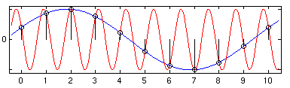
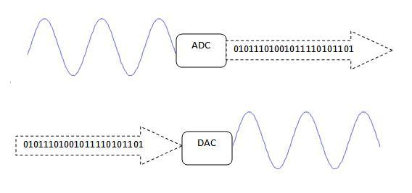
EECS 373
Design of Microprocessor-Based Systems
Prabal Dutta
University of Michigan
Lecture 11: Sampling, ADCs, and DACs
Oct 11, 2011
Slides adapted from Mark Brehob, Jonathan Hui & Steve Reinhardt
http://www.cs.berkeley.edu/~jwhui

Slide 2
Announcements
HW2/practice midterm posted
  Due Oct 19 at noon!
  Slide under door in 4773 CSE
  Come to Oct 13 class with questions

Slide 3
Midcourse Feedback
What are the GSI lab hours?
  http://tinyurl.com/3lxyu4s
Labs are in flux during the week
  Labs are still evolving; sometimes this takes longer than one would like
GSI’s not communicating w/ each other about labs
  This is now being discussed; we’re looking for solutions
More syllabus clarity needed – need lab placeholders
  Done
Lab websites not synchronized
  http://www.eecs.umich.edu/courses/eecs373/labs.html → main site
Unsure what will be on the midterm
  HW#2 (and practice midterm) now posted. Due in 8 days.
Labs are too long
  Range of skills → some finish during lab; others take longer
Hard to balance labs + homework/project
  Labs 4 & 5 now have extended deadlines
Verilog primer needed (or comment code)
  Links, sample code, simple verilog-xl CAEN toolchain help posted
Need some feedback on assembly language
  Worked out sample code now posted
Use a forum rather than email

Slide 4
Outline
Announcements
Sampling
DACs
ADCs & Errors

Slide 5
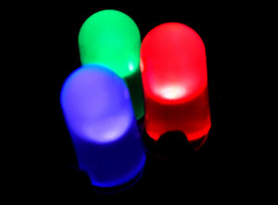
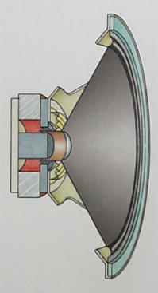
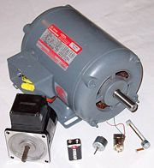
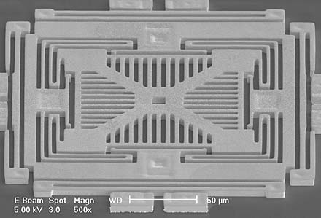
We live in an analog world
Everything in the physical world is an analog signal
  Sound, light, temperature, pressure
Need to convert into electrical signals
  Transducers: converts one type of energy to another
    Electro-mechanical, Photonic, Electrical, …
  Examples
    Microphone/speaker
    Thermocouples
    Accelerometers

Slide 6
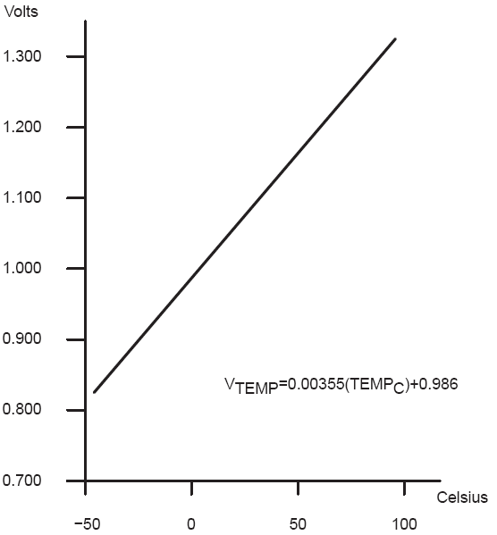
Transducers convert one form of energy into another
Transducers
  Allow us to convert physical phenomena to a voltage potential in a well-defined way.
A transducer is a device that converts one type of energy to another. The conversion can be to/from
electrical, electro-mechanical, electromagnetic, photonic, photovoltaic, or any other form of energy.
While the term transducer commonly implies use as a sensor/detector, any device which converts energy
can be considered a transducer. – Wikipedia.

Slide 7
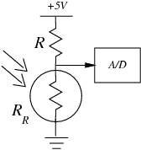
Convert light to voltage with a CdS photocell
V_{signal} = (+5V) R_{R}/(R + R_{R})
Choose R=R_{R} at median of intended range
Cadmium Sulfide (CdS)
Cheap, low current
t_{RC} = C_{l}*(R+R_{R})
  Typically R~50-200kΩ
  C~20pF
  So, t_{RC}~20-80uS
  f_{RC} ~ 10-50kHz
Source: Forrest Brewer

Slide 8
Many other common sensors (some digital)
Force
  strain gauges - foil, conductive ink
  conductive rubber
  rheostatic fluids
    Piezorestive (needs bridge)
  piezoelectric films
  capacitive force
    Charge source
Sound
  Microphones
    Both current and charge versions
  Sonar
    Usually Piezoelectric
Position
  microswitches
  shaft encoders
  gyros
Acceleration
  MEMS
  Pendulum
Monitoring
  Battery-level
    voltage
  Motor current
    Stall/velocity
  Temperature
    Voltage/Current Source
Field
  Antenna
  Magnetic
    Hall effect
    Flux Gate
Location
  Permittivity
  Dielectric
Source: Forrest Brewer

Slide 9
Going from analog to digital
What we want
How we have to get there
Physical
Phenomena
Engineering Units
Physical
Phenomena
Voltage or
Current
ADC Counts
Engineering Units
Sensor
ADC
Software

Slide 10

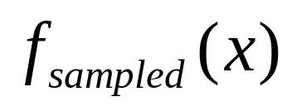


Representing an analog signal digitally
How do we represent an analog signal?
  As a time series of discrete values
  → On MCU: read the ADC data register periodically
V
Counts

Slide 11



Choosing the horizontal range
What do the sample values represent?
  Some fraction within the range of values
  → What range to use?
Range Too Small
Range Too Big
Ideal Range

Slide 12
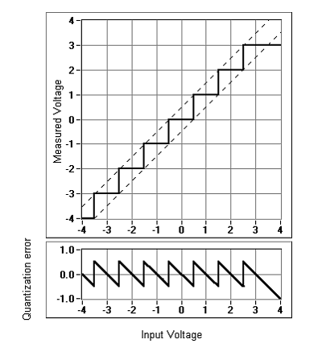
Choosing the horizontal granularity
Resolution
  Number of discrete values that represent a range of analog values
  MSP430: 12-bit ADC
    4096 values
    Range / 4096 = Step
  Larger range ➔ less information
Quantization Error
  How far off discrete value is from actual
  ½ LSB → Range / 8192
  Larger range ➔ larger error

Slide 13
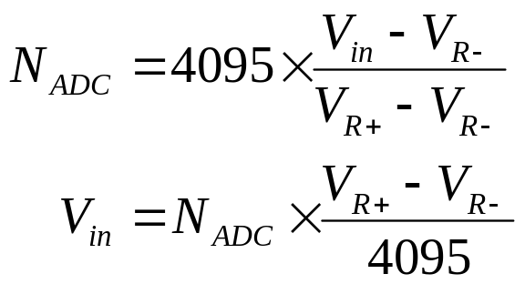


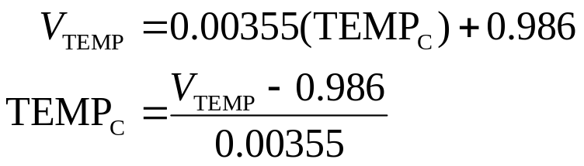
Converting between voltages,
ADC counts, and engineering units
Converting: ADC counts ⬄ Voltage
Converting: Voltage ⬄ Engineering Units

Slide 14
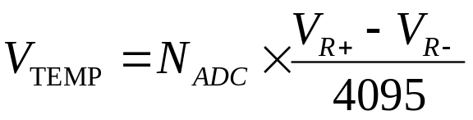
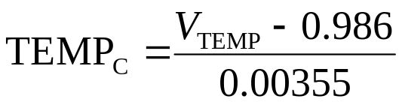
A note about sampling and arithmetic
Converting values in 16-bit MCUs
  vtemp = adccount/4095 * 1.5;
  tempc = (vtemp-0.986)/0.00355;
  → tempc = 0
Fixed point operations
  Need to worry about underflow and overflow
Floating point operations
  They can be costly on the node

Slide 15
Choosing the sample rate
What sample rate do we need?
  Too little: we can’t reconstruct the signal we care about
  Too much: waste computation, energy, resources
    Example: 2-bytes per sample, 4 kHz → 8 kB / second

Slide 16


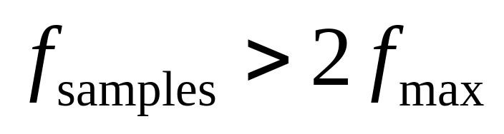
Shannon-Nyquist sampling theorem
If a continuous-time signal contains no frequencies higher than , it can be completely determined by discrete samples taken at a rate:
Example:
  Humans can process audio signals 20 Hz – 20 KHz
  Audio CDs: sampled at 44.1 KHz

Slide 17
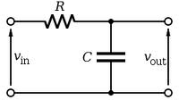
Use anti-aliasing filters on ADC inputs to ensure that Shannon-Nyquist is satisfied
Aliasing
  Different frequencies are indistinguishable when they are sampled.
Condition the input signal using a low-pass filter
  Removes high-frequency components
  (a.k.a. anti-aliasing filter)

Slide 18
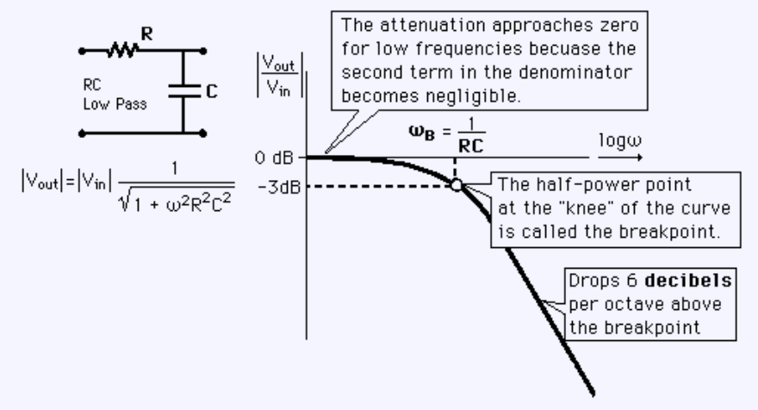
Designing the anti-aliasing filter
Note
  ω is in radians
  ω = 2πf
Exercise: Find an R+C pair so that the half-power point occurs at 30 Hz

Slide 19
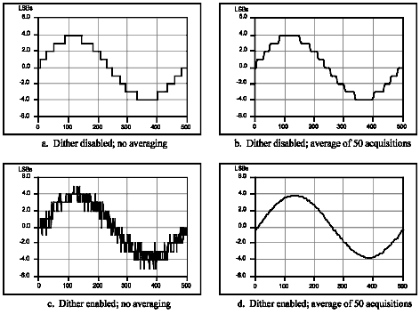
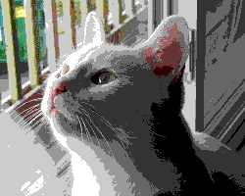
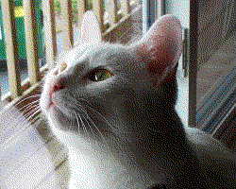
Can use dithering to deal with quantization
Dithering
  Quantization errors can result in large-scale patterns that don’t accurately describe the analog signal
  Introduce random (white) noise to randomize the quantization error.
Direct Samples
Dithered Samples

Slide 20
Lots of other issues
Might need anti-imaging filter
Cost and power play a role
Might be able to avoid analog all together
  Think PWM when dealing with motors…

Slide 21
Outline
Announcements
Sampling
DACs
ADCs

Slide 22
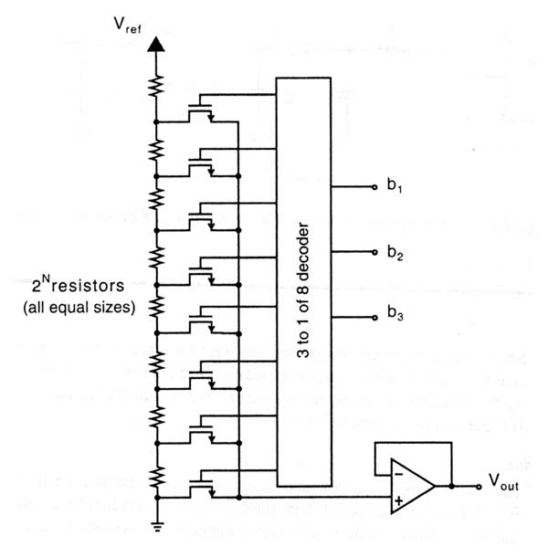
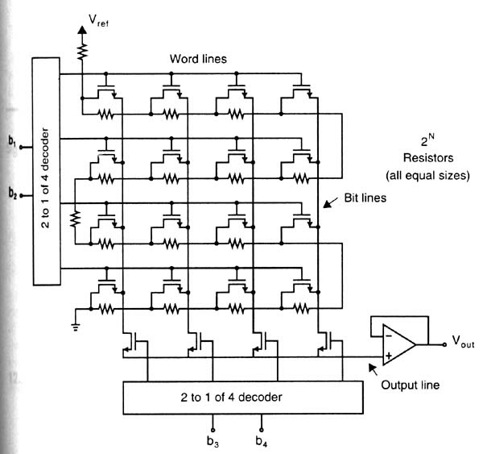
A decoder-based DAC architecture in linear and folded forms

Slide 23
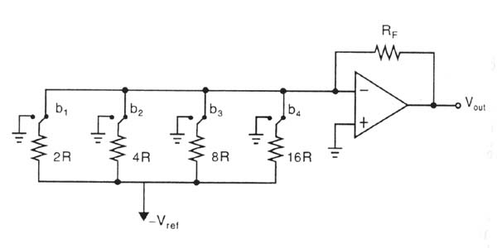
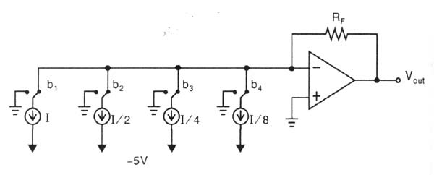
A binary-scaled DAC architecture in linear and folded forms
Much more efficient
Monotonicity not guaranteed
May experiences glitches

Slide 24
DAC #1: Voltage Divider
Din
Fast
Size (transistors, switches)?
Accuracy?
Monotonicity?
Vref
2
2-to-4 decoder
R
R
R
Vout
R

Slide 25
DAC #2: R/2R Ladder
Vref
R
R
R
2R
2R
2R
2R
2R
Iout
D3 (MSB)
D2
D1
D0 (LSB)
Size?
Accuracy?
Monotonicity? (Consider 0111 -> 1000)

Slide 26
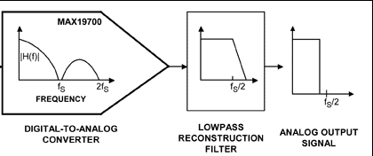

DAC output signal conditioning
Often use a low-pass filter
May need a unity gain op amp for drive strength

Slide 27
Outline
Announcements
Sampling
DACs
ADCs

Slide 28
ADC #1: Flash
Vref
Vin
priority
encoder
R
+
_
3
R
+
_
2
2
Dout
R
+
_
1
R
Vcc
0

Slide 29
ADC #2: Single-Slope Integration
Vin
+
_
done
Vcc
I
C
EN*
n-bit counter
CLK
Start: Reset counter, discharge C.
Charge C at fixed current I until Vc > Vin . How should C, I, n, and CLK be related?
Final counter value is Dout.
Conversion may take several milliseconds.
Good differential linearity.
Absolute linearity depends on precision of C, I, and clock.
Notes:
DV = Vref / 2^n
DQ = C DV
I = DQ/DT
➔ I DT / C = Vref / 2^n

Slide 30
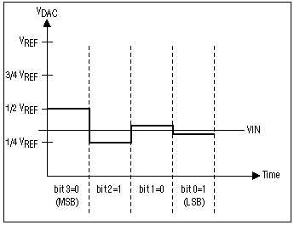
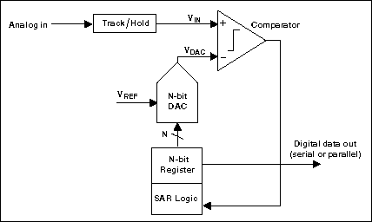
ADC #3: Successive Approximation (SAR)
1 Sample → Multiple cycles
Requires N-cycles per sample where N is # of bits
Goes from MSB to LSB
Not good for high-speed ADCs
Notes:
DV = Vref / 2^n
DQ = C DV
I = DQ/DT
➔ I DT / C = Vref / 2^n

Slide 31
Errors and ADCs
Figures and some text from:
  Understanding analog to digital converter specifications. By Len Staller
  http://www.embedded.com/showArticle.jhtml?articleID=60403334
Key concept here is that the specification provides worst case values.

Slide 32
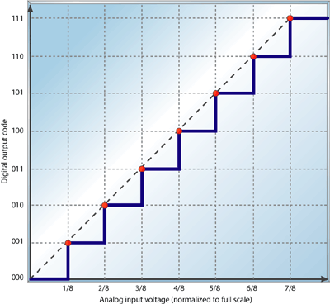

Slide 33
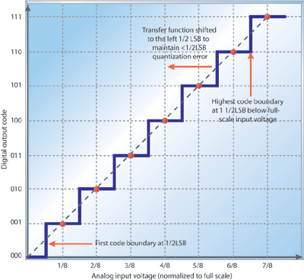

Slide 34
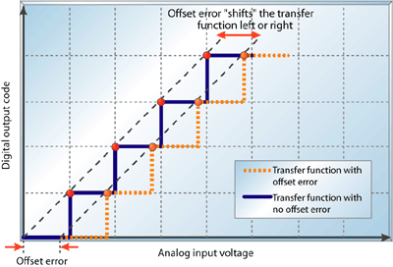
Sometimes the intentional ½ LSB shift is included here!

Slide 35
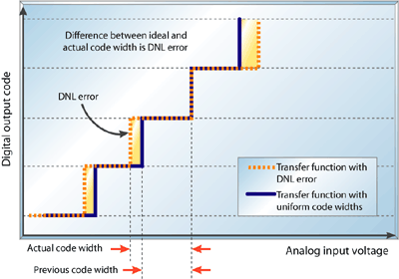

Differential non-liniearity
DNL value given in a spec is the worst-case
(Same with all the others…)

Slide 36
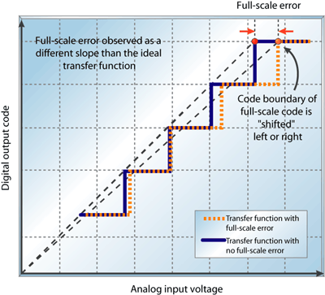
Full-scale error is also sometimes called “gain error”
full-scale error is the difference between the ideal code transition to the highest
output code and the actual transition to the output code when the offset error is zero.

Slide 37
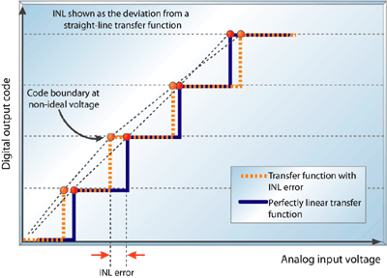
The integral nonlinearity (INL) is the deviation of an ADC's transfer function from a straight line.
This line is often a best-fit line among the points in the plot but can also be a line that connects
the highest and lowest data points, or endpoints. INL is determined by measuring the voltage
at which all code transitions occur and comparing them to the ideal. The difference between
the ideal voltage levels at which code transitions occur and the actual voltage is the INL error,
expressed in LSBs. INL error at any given point in an ADC's transfer function is the accumulation
of all DNL errors of all previous (or lower) ADC codes, hence it's called integral nonlinearity.

Slide 38
Questions?
Comments?
Discussion?

